Slide 1
Part 1:
Data & Networks
Notes:
Welcome to our first lesson. In this video, we will learn about the importance of data and databases, as well as the tools we use to share and manage data. The final component of this video is an introduction to the language and common commands we use to create data structures as well as manipulate the data that is stored in those structures.

Slide 2












What’s the big deal about DATA????
Notes:
So what is special about data? It is the new currency in the business world. Many gamers pay a subscription fee to be able to store their data online and play against players from around the world. Where do you think your upgrades and weapons are stored? When you buy something at the market and scan your membership card, watch a You Tube video, buy at Amazon, or search at Google, they track your actions, add it to existing data, then calculate trends. All this data is used to generate coupons and advertisements to manipulate us into buying what they want us to buy. At Stop & Shop, are the printed coupons usually for your preferred brands or are they usually for a different brand? Maybe the brand is more expensive or maybe they have overstock of that item. Quick trick to try: Go to Amazon.com and look at a series of items like a group of books, video games, or clothing. Then go to TurnTo10.com, look around the main page and go to a few pages within their site. DO you notice any advertisements matching items you looked at? Your data is being shared and sold in order to find ways of making someone else money.

Slide 3
The three hardware components of a client/server system
Network - A network consists of two or more computers that are linked in order to share resources (such as printers and CDs), exchange files, or allow electronic communications.
Clients - A client is a computer or software that connects to and uses the resources of a remote computer, or server.
Server - A network server is a computer system, which is used as the central repository of data and various programs that are shared by users in a network.
Notes:
Data can be stored locally, but also can be stored on one or more servers in order to distribute information near and far. Think of using your ATM/Debit/Credit card while on a trip. Before data networks, you would have had to guess how much money you needed and get it at your local bank. So, we need to know a little about networks and components of a network. Networks link computers and related devices to allow sharing data. Clients are computers that request information. Think of your browser requesting information Google. Google Servers receive your request, calculate what you need, then share the resulting information with you. In a Peer-to-Peer network, the computers take turns being clients and servers, based on ours and others’ needs. For example, lets say my computer has a color printer attached to it and my partner has a 3D printer attached to her computer. Both printers could be shared by their computers. If I need a 3D print, my partner’s computer acts as the server. If my partner needs a color printout, my computer acts as the server. Whoever is requesting the print job acts as the client.

Slide 4
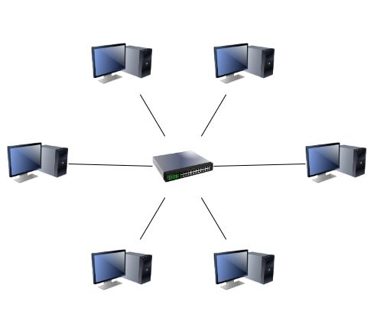
Notes:
A LAN is a network that manages a series of local resources, such as your home computers, printers, mobile devices.
One type of LAN configuration is known as peer-to-peer where each computer/device acts on its own and may share some resources locally, like multiple types of printers. Client-Server networks can be local and have one primary computer that stores and distributes data received from each of the clients/workstations.

Slide 5
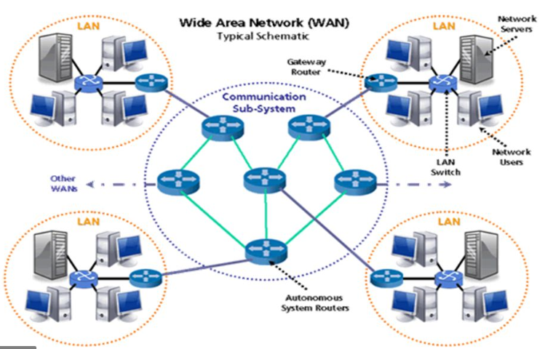
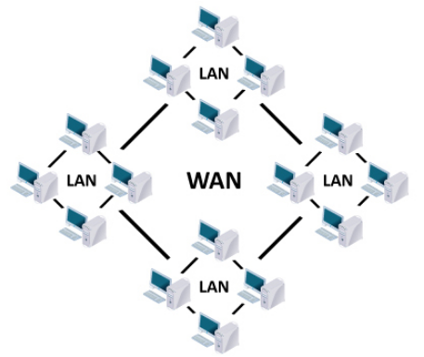
Notes:
WAN’s essentially are a series of LAN’s that are connected over a distance, usually via high-speed data lines and/or satellites. The Internet and AOL are two examples of WAN’s They are a series of servers connected over distances and act as data sources and connectors to other networks.

Slide 6
Notes:
A Client program sends a request to the Database Server. This request specifies the wanted table(s), fields, and data criteria, such as searching only for Suburu cars that were made in the year 2000 and greater (new). The server receives the request, finds the records that match the criteria, then limits the results to the fields that were specified. For example, if we care about your email address but not your mailing address, I only ask for the field that holds people’s email address, maybe “Email”

Slide 7
Notes:
The database software and server that we use is Microsoft SQL Server (Ver 16/18). It receives commands, modifies, and retrieves/shares data.
The Client program that interfaces with SQL Server is SQL Server Management Studio. It sends, retrieves, and displays data.
Unlike some programming languages you may have worked with, SQL is Freeform & Case Insensitive. Meaning you can space it out and format the text that is comfortable to you.

Slide 8
Part 2:
Relational Databases (DB’s)
Notes:
Welcome to our first lesson. In this video, we will learn about the importance of data and databases, as well as the tools we use to share and manage data. The final component of this video is an introduction to the language and common commands we use to create data structures as well as manipulate the data that is stored in those structures.

Slide 9
Back in the old days…
Each table was its own file and sorting data meant creating a separate file with the data in the specified sequence (index).

Slide 10
Fields
Records

Slide 11
A table is a collection of related data held in a table format within a database. It consists of columns, and rows. For example a table of cars might list the makes, models, year, mileage, # of doors, and price of each car.
a column/field is a set of data values, all of a single type to represent a particular property of an object, person, action. Example: # of car doors on each vehicle.
a row/record represents a single, implicitly structured data item in a table. Example: the make, model, year, mileage, # of doors, and price of one particular car at a time.
An index is a data structure that improves the speed of data retrieval operations on a database table, usually at the cost of additional writes and storage space to maintain the index data structure. Example: Ordering all cars by price (lowest to highest – Ascending).

Slide 12
A Primary Key is a field in a table which uniquely identifies each row/record in a database table. Primary keys must contain unique values. A primary key column cannot have NULL values. A table can have only one primary key, which may consist of single or multiple fields. For example a table of cars use a VIN # as a unique identifier.
A Composite Primary Key is a primary key field which consists of multiple fields. For example a table for registered cars may use the License Plate text/numbers and the State to avoid duplicates across states. “Lambert” on a RI plate would be different from “Lambert in MA.
Null is the absence of a value. Example: If a cars dealership lists a car missing their price, you lack a value to use. Think of people who lack a middle name when they are filling out a form…they leave it empty. Did they forget to answer it, lack the info, or meant to leave it blank?

Slide 14
A Foreign Key is a column or group of columns in a relational database table that provides a link between data in two tables. These are usually primary keys from another table. For example, there may be a table of Car Makes with each Maker having an Primary Key (ID) that can be used to distinguish a particular car’s manufacturer in the Cars’ table. Another example: you have one Social Security #, yet each credit card, employer, and school you work with have this info about you.

Slide 15
Part 3:
Chunking & Organizing Data
Notes:
Welcome to our first lesson. In this video, we will learn about the importance of data and databases, as well as the tools we use to share and manage data. The final component of this video is an introduction to the language and common commands we use to create data structures as well as manipulate the data that is stored in those structures.

Slide 16
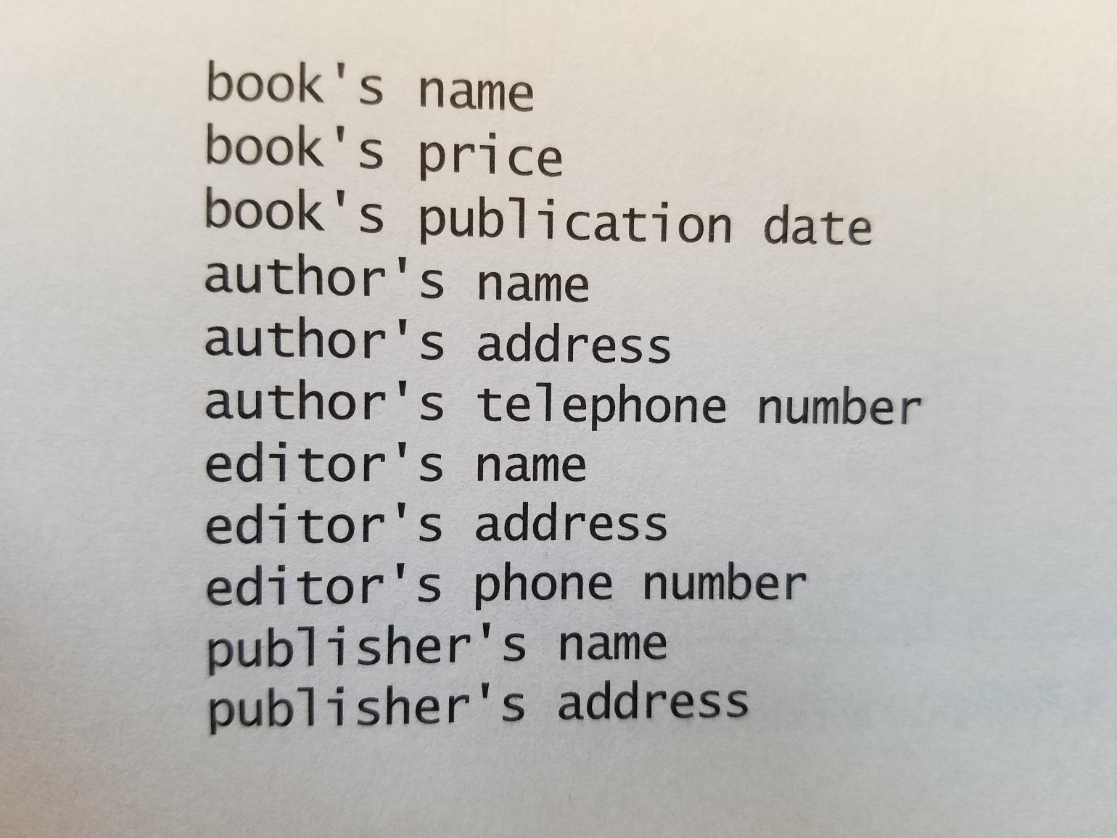
Notes:
This is an example of data you may have about any book, usually from one of the first few pages of a book. You may have noticed that there are certain attributes that belong to the book, others that pertain to the author, as well as those of the editors and publisher.

Slide 17
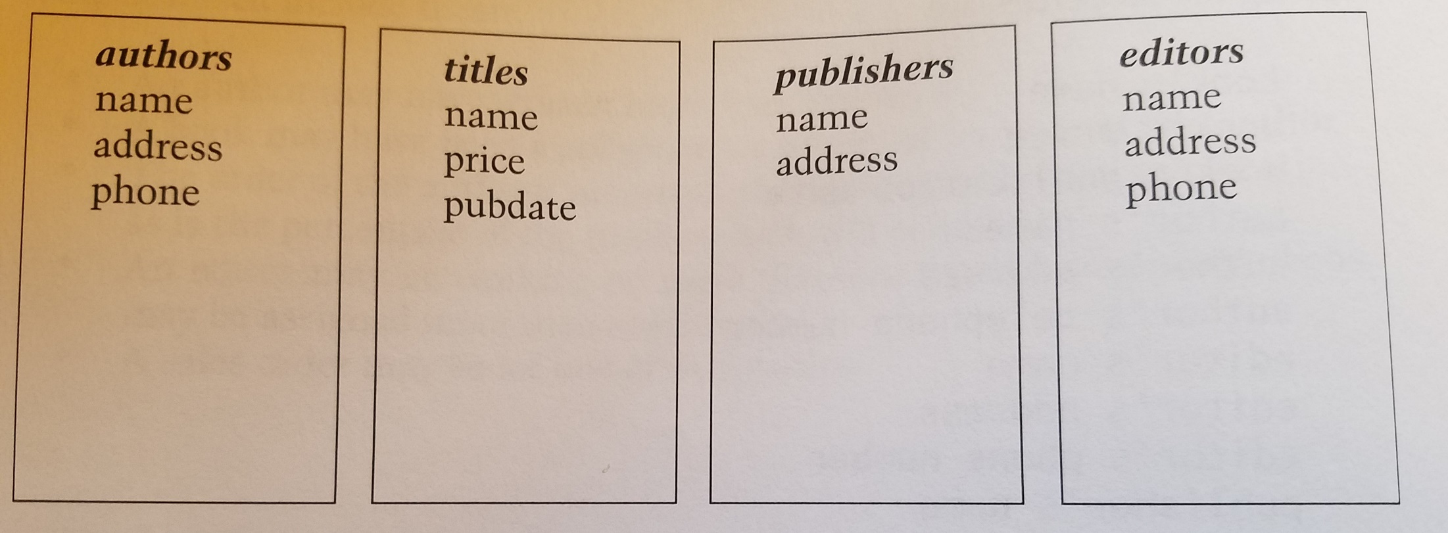
Notes:
Here, we broke apart the data into specifically related groups of data. Think about and author of many books…Will they always have the same publisher and editor? Is it possible that an editor changes the publisher that they work for? This separation of the data allows these changes and growth.

Slide 18
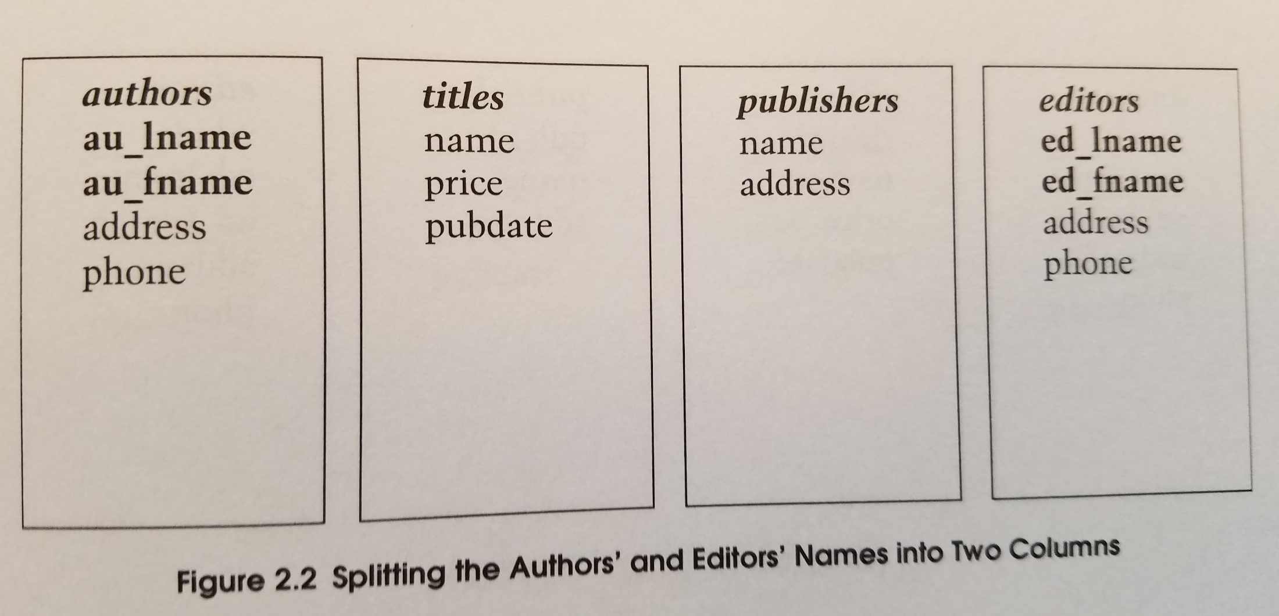
Notes:
Sometimes data can be clumped together in our initial stages, but it is a good habit to chunk the larger or compound data into smaller individual components of data, such as first name and last name, making it easier to sort and search information.

Slide 19
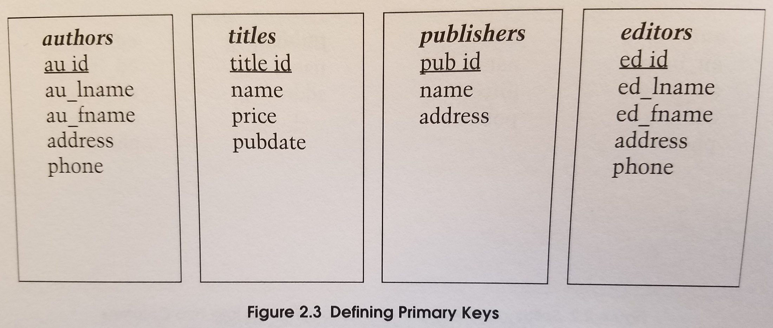
Notes:
Just like you were likely given a Social Security Number, each time we add a new author, they will get an ID that is specific to that person. Another example is your driver’s license #, your license plater (hopefully), and your student ID. What do you think is specific about you with each of your online accounts with web sites like Amazon.com, Google, Facebook?

Slide 20
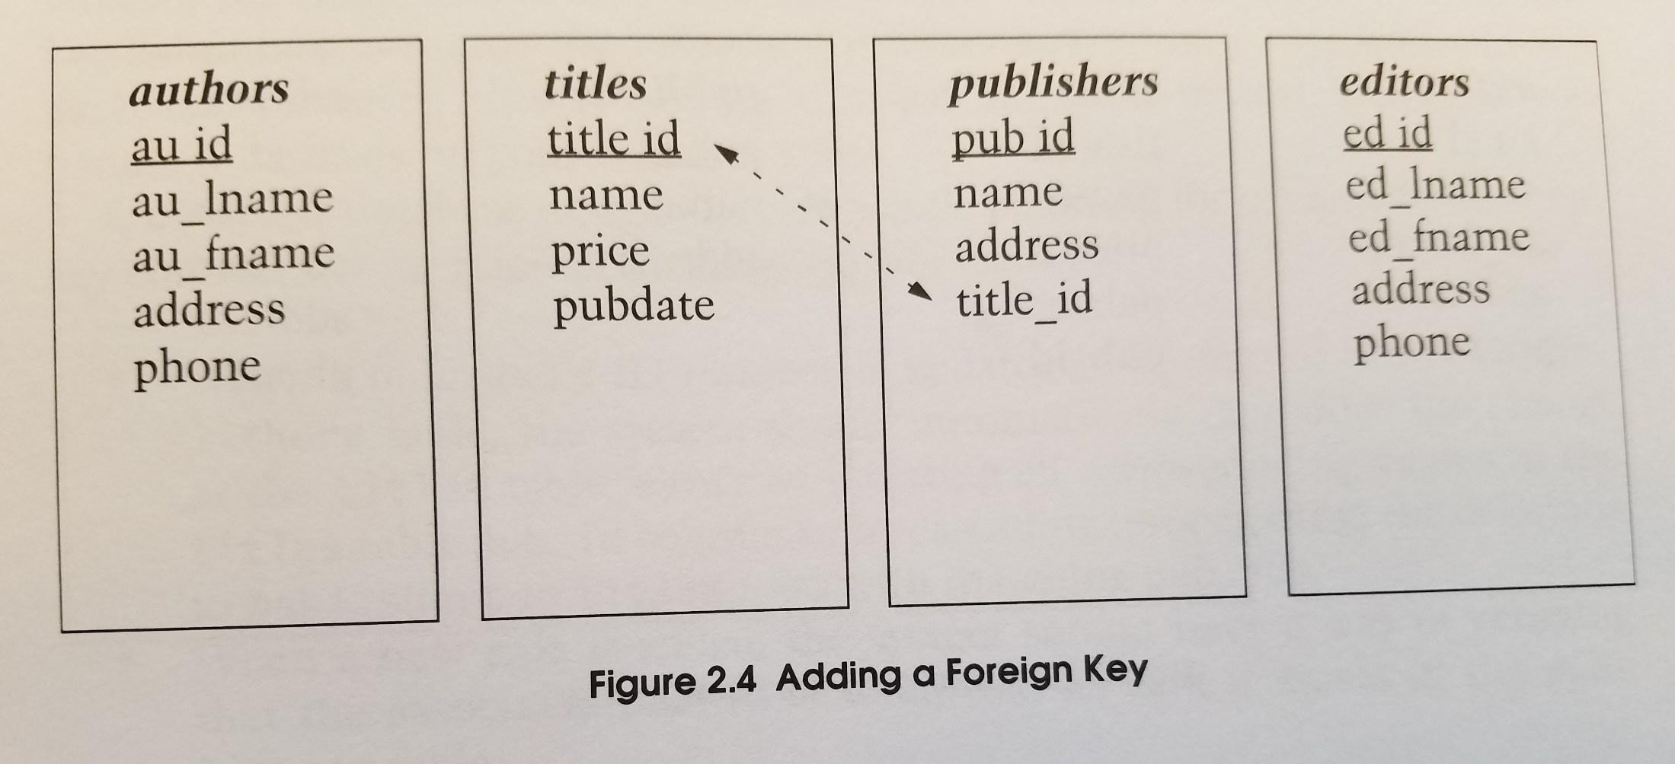
Notes:
A foreign key is a primary key from another table that allows us to create relationships. In this case, we are stating that a publisher is connected with one particular book title. When we look up the data on the publisher, we can get their name and address, as well as the id that links us to a particular book. Does that make sense? Ask questions…Now, I want you to think about a publisher only having one book being published. Does that sound realistic?

Slide 21
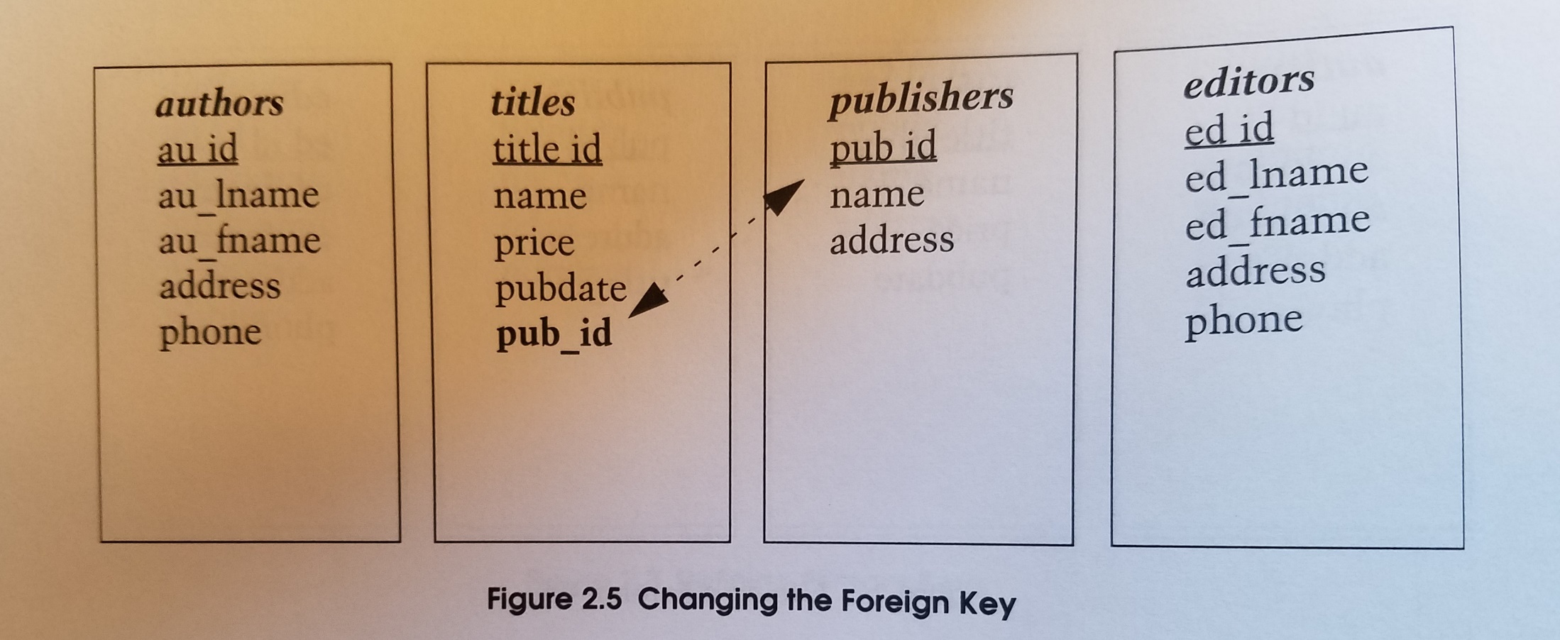
Notes:
Thinking about it, it may make sense to connect a publisher with each book title. So…for each book we add, we can choose from a potential list of publishers and store that Pub_ID. This is great to keep what is known as normalcy….reducing redundancy of the same info. Imaging that George Lucas, changed his last name to “Skywalker”, this relationship allows me to store George’s info in one table and many books could link to that one record. Editing the one spot would be all it takes.

Slide 22
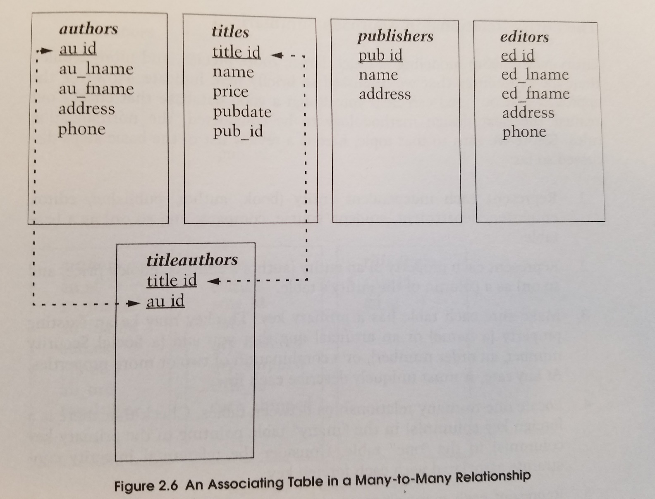
Notes:
Now…my first initial thoughts when I saw the titles table was that I wanted to throw an Author ID (au_id) and Editor’s ID (ed_id) into the Titles table as foreign keys, but I had to think for a moment. Not all books have one author or editor. In many cases there are multiple authors and/or editors. So…We can create a TitleAuthors table that would allow a book to be connected to many authros by adding a new record/row with the same Title_ID but with another Author ID. I know that this takes time to process. I wanted to introduce this concept so it can grow and link within your mind as we progress from working with one table, to two tables, and beyond.

Slide 23
Part 4:
SQL Server & SQL Command Basics
Notes:
Welcome to our first lesson. In this video, we will learn about the importance of data and databases, as well as the tools we use to share and manage data. The final component of this video is an introduction to the language and common commands we use to create data structures as well as manipulate the data that is stored in those structures.

Slide 24
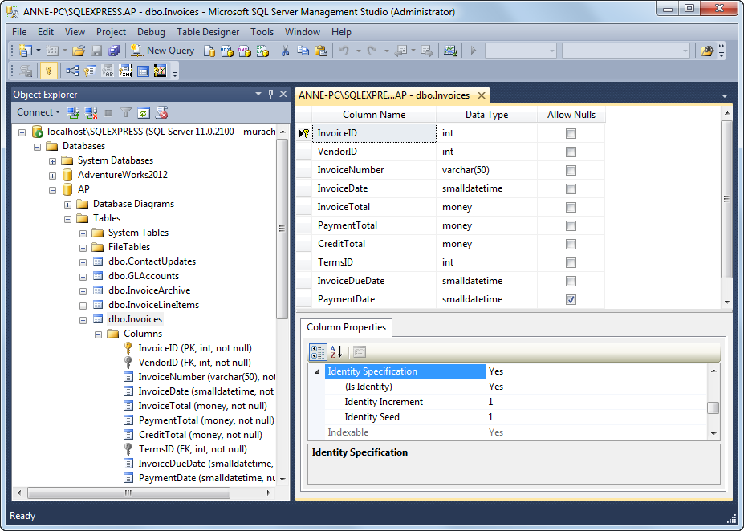
Notes:
On the left side of the screen you can see the hierarchy map. At the top, you can see the server info, then a listing of different databases on that server. In one database, we cas see its tables and the specific columns/fields within the Invoices table. On the right-top, we have a closer look at the columns/fields on this table and can adjust properties of those fields. When one field is highlighted, the bottom-right shows specific add-on features/capabilities of that specific field data type.

Slide 25
A Default Value is a specific value that will be placed into a field in place of a Null, when someone does not provide a value for a field when entering data.
Notes:
These are the data types. I avoid char and varchar because they pad fields with spaces. For example, If I create a FirstName field with a size that allows up to 20 characters for a name and put a 5-character name like “Scott” in it, the DB will fill the remaining 15 characters with spaces “_“. When dealing with money, many programmers still deal with floats or reals for compatibility with competing databases like Oracle.
The items highlighted in Yellow are typical data types we use for databases.

Slide 26
Relational Database Structure You should know that because the physical structure of a relational database is defined and managed by the DBMS, it’s not necessary to define that structure within the programs that use the database. Instead, you can simply refer to the tables and columns you want to use by name and the DBMS will take care of the rest.
How knowing “standard SQL” helps you
Basic SQL statements are the same for all SQL dialects.
Once you know one SQL dialect, you can easily learn others.
How knowing “standard SQL” does not help you
Any non-trivial application will require modification when moved from one SQL database to another.
Notes:
Microsoft SQL Server will receive our SQL commands for certain types of data from our client program (Management Studio). The server will collect only the data that we requested from one or more tables, then return only that data back to the client program making the request. Standard SQL should work in all DataBase Management Systems (DBMS), but you should learn any specific add-on’s from the specific DBMS that can benefit you.

Slide 27
Notes:
Data Definition Language statements allow us to modify database and table structures. We can also use the GUI within the Management Studio while seeing the GUI build the text that builds the necessary statements to perform the modifications.
Data Manipulation Language statements consist of 4 core SQL commands that allow us to interact with Data within the databases and tables.

Slide 28
Notes:
Examples of code to create a DB or a Table with specific fields and field types.

Slide 29
Notes:
These are other examples to modify a table structure after it has been created. More of this to come as we progress through the course. The next lesson will take us through logging into our server and your personal databases. Once we can get connected, we will start creating a simple table and adding some data. Please share your questions, ideas, and feedback so we can create great learning opportunities for you and the rest of the class.

